Slide 1
.Data Management and Database Design Jobs DB Project Team Name- Deviants Team Members – Harshil Mehta 001470356 Srikrishna Ram 001415814

Slide 2
What’s our goal?
First, matching the job seekers with the right employers
Second, provide guidance to aspiring job seekers on the skills that are in demand so that they can build them to stay relevant in the job market.

Slide 3
What we have done so far…
We got the data from scrapping Indeed website
Information related to 331 companies in Data Science domain
The dataset includes Job Description, Salary, Location etc.
Getting Social Media links of the companies
Normalization of the database in order to reduce data redundancy
Creating Use Cases that are practically useful
Adding index to our database for increase in performance and creating functions which are practically useful
Creating Stored procedures which are practically useful

Slide 4

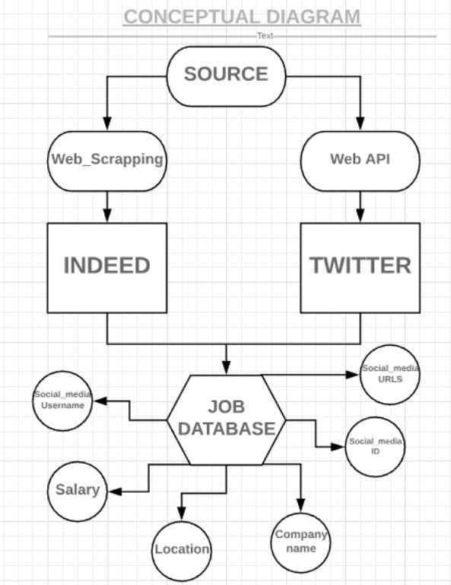



Conceptual Model

Slide 5
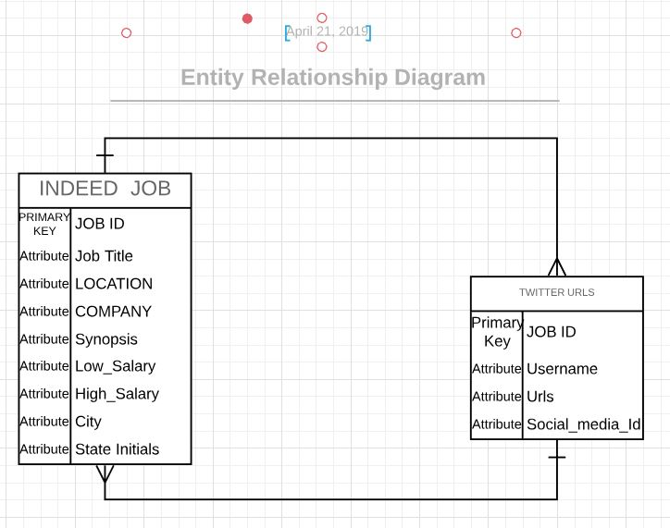
E R Diagram

Slide 6
Data Scarping Template
http://www.indeed.com/jobs?q=data+scientist+%2420%2C000&l={}&start={}
There are different parameters we can alter to scrape the data:
1: q for the job search
2: This is followed by "+20,000" to return results with salaries (or expected salaries >$20,000)
3: l for a location
4: start for what result number to start on

Slide 7
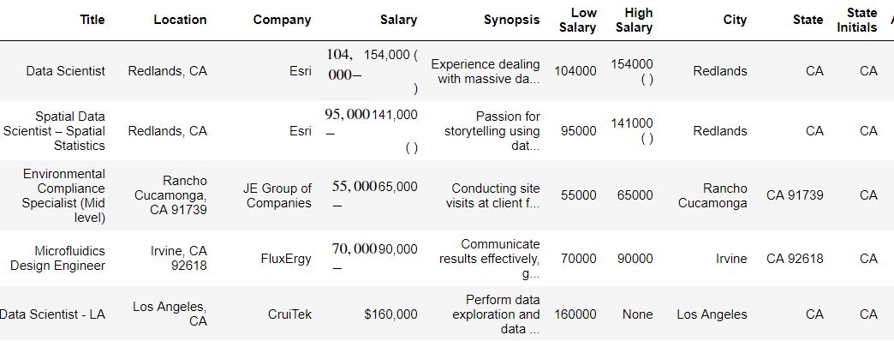
Database obtained from Web Scrapping of Indeed

Slide 8
Thank You

